Slide 1
Diagnosing the Offset
September 23, 2020

Slide 2

Last Week Recap
Using the Inversion technique (flipping the 0s with 1s and vice versa), we tried to exploit the asymmetry
However, this technique did not work, since inverting the circuit did nothing to energy computed by the noise model.
Possible Issues:
The offset between noisy energy and ideal energy is caused by a different source of noise. Why should this noise be asymmetrical though?
The inversion technique may work but number of gates in VQE circuit for H2 atom is too small

Slide 3
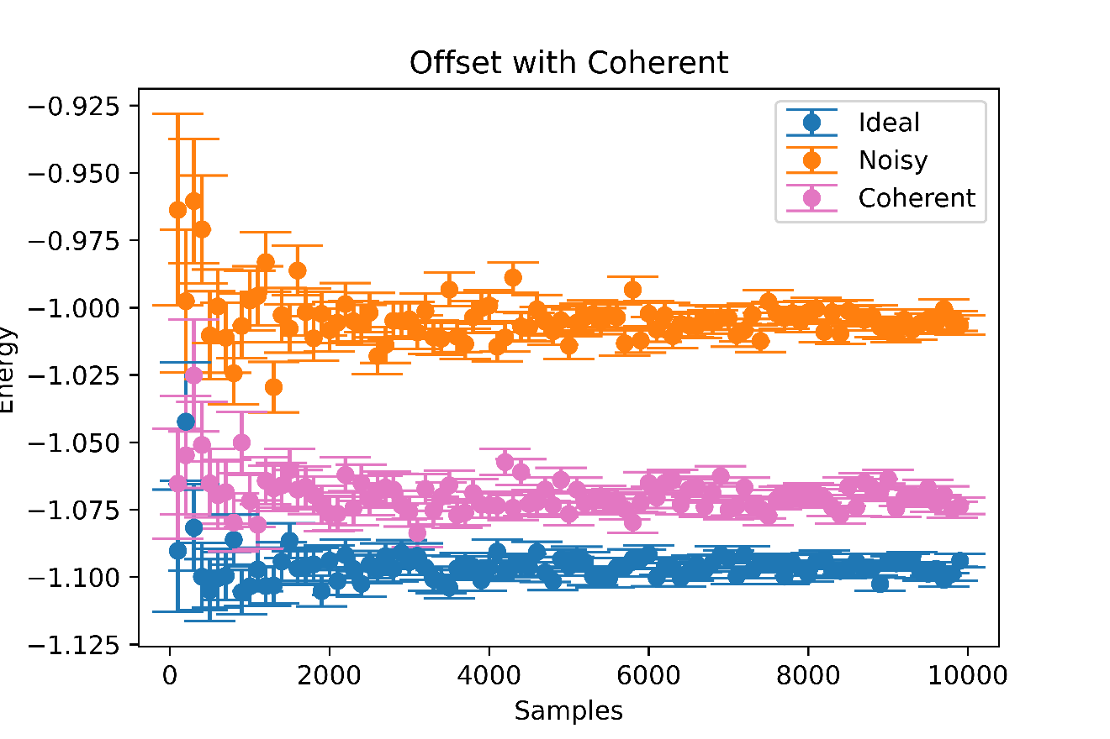
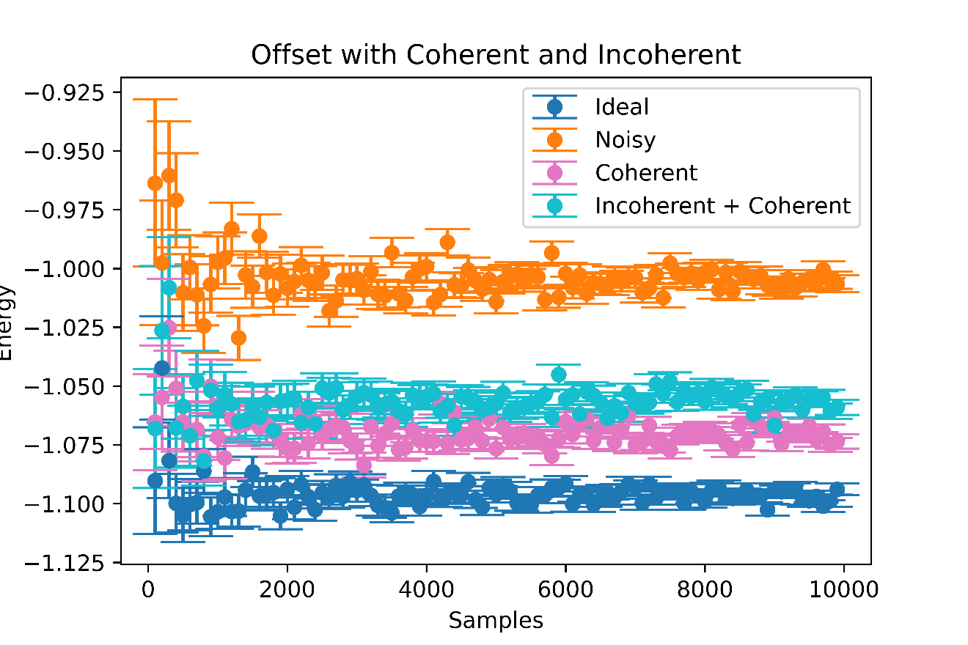
Issue 1: Coherent Errors and Incoherent Errors

Slide 4
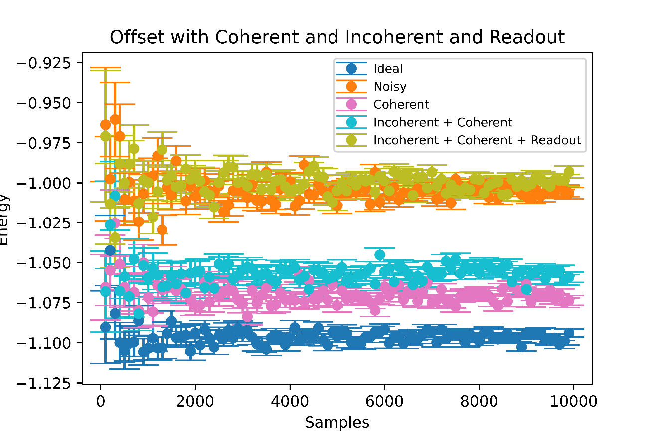
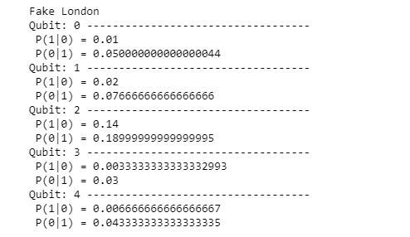
Issue 1: Readout Errors
After adding in all 3 kind of errors, we do get close to the noise model’s energy calculation.
Clearly, readout errors cause the greatest deviation.
Something Interesting: the measurement error rates are asymmetric
What happens when we switch them? Do we get the same results, for example, if for qubit 0 , P(0|1) = 0.05 and P(1|0) = 0.05?
Let’s call this Issue 1.1: Measurement Assymetry

Slide 5
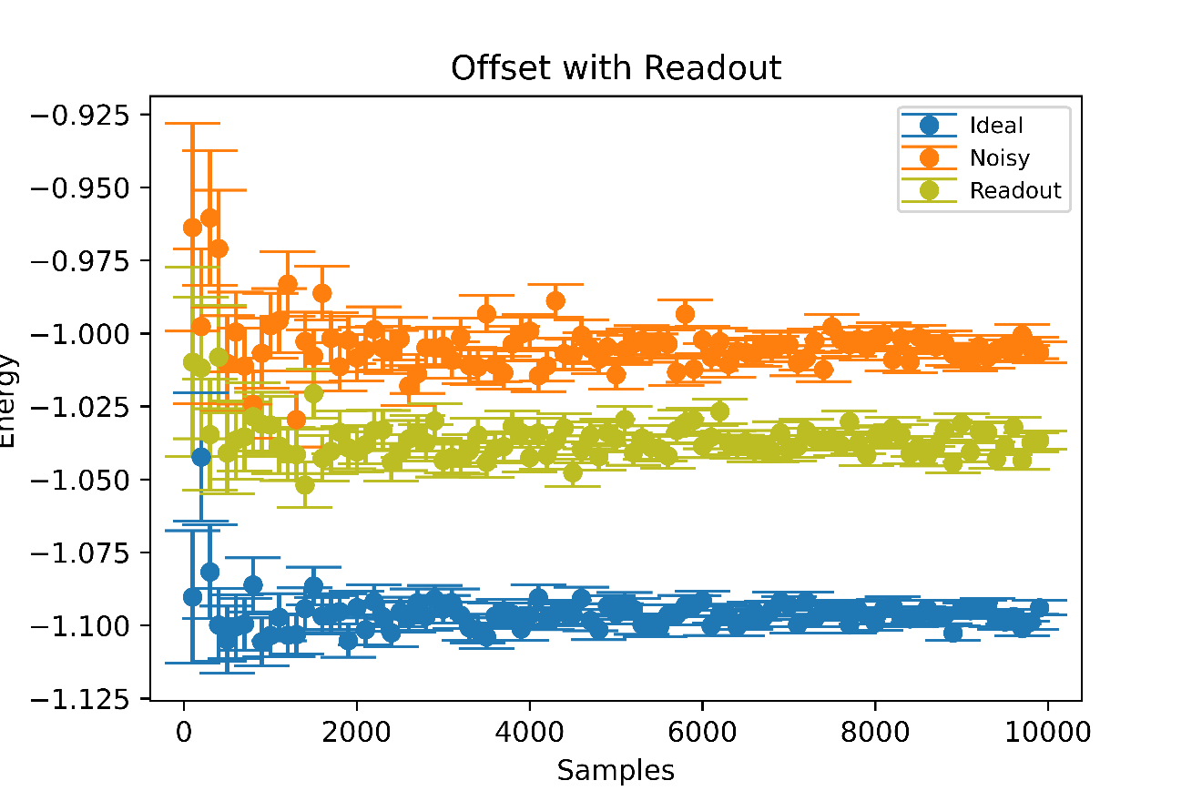
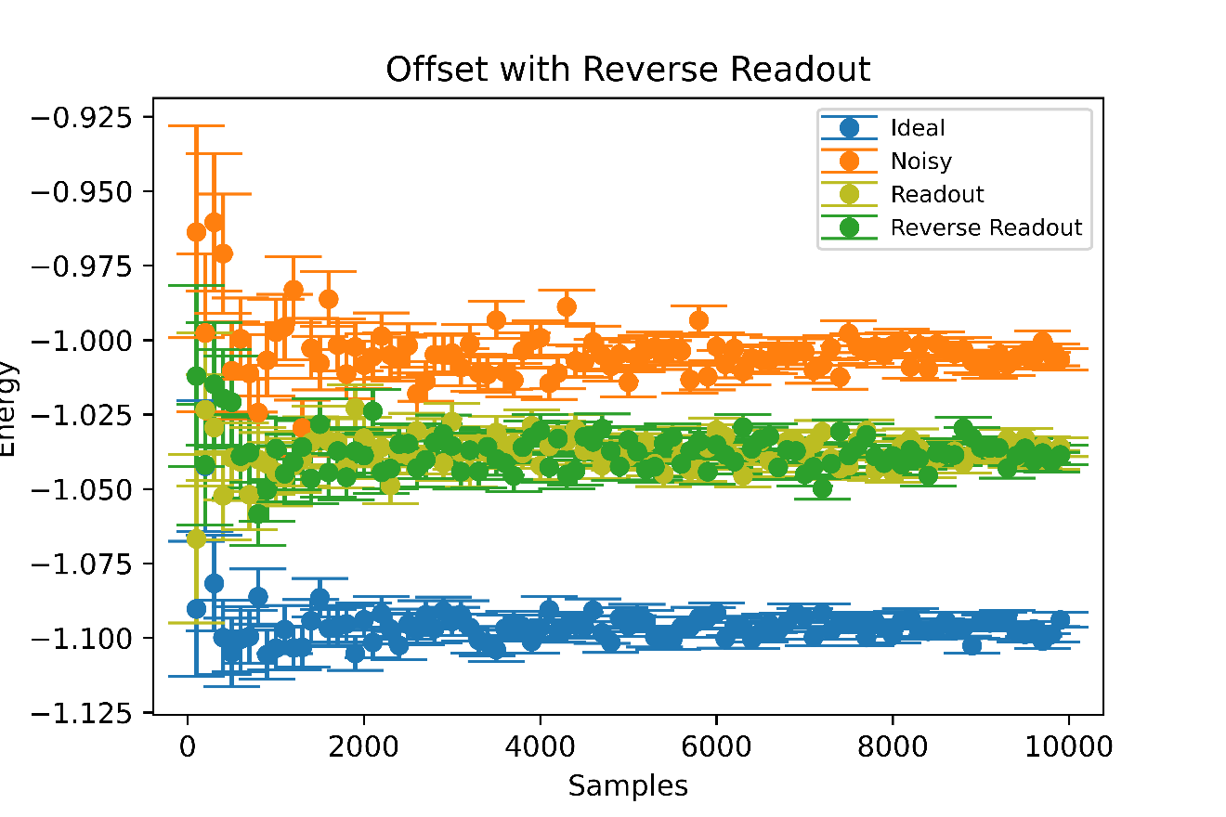
Issue 1.1: Measurement Asymmetry
Reversing the qubit error rates, however, does nothing to the energy value
Possible Explanation?

Slide 6
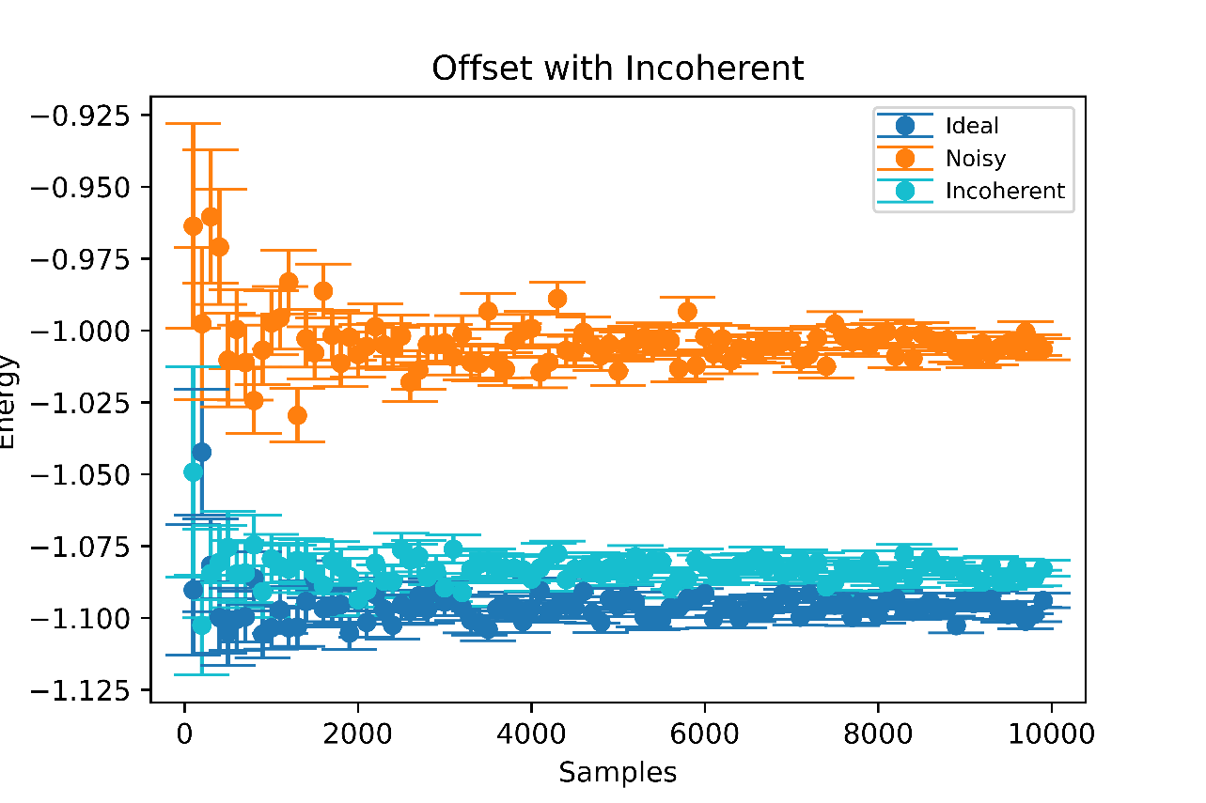
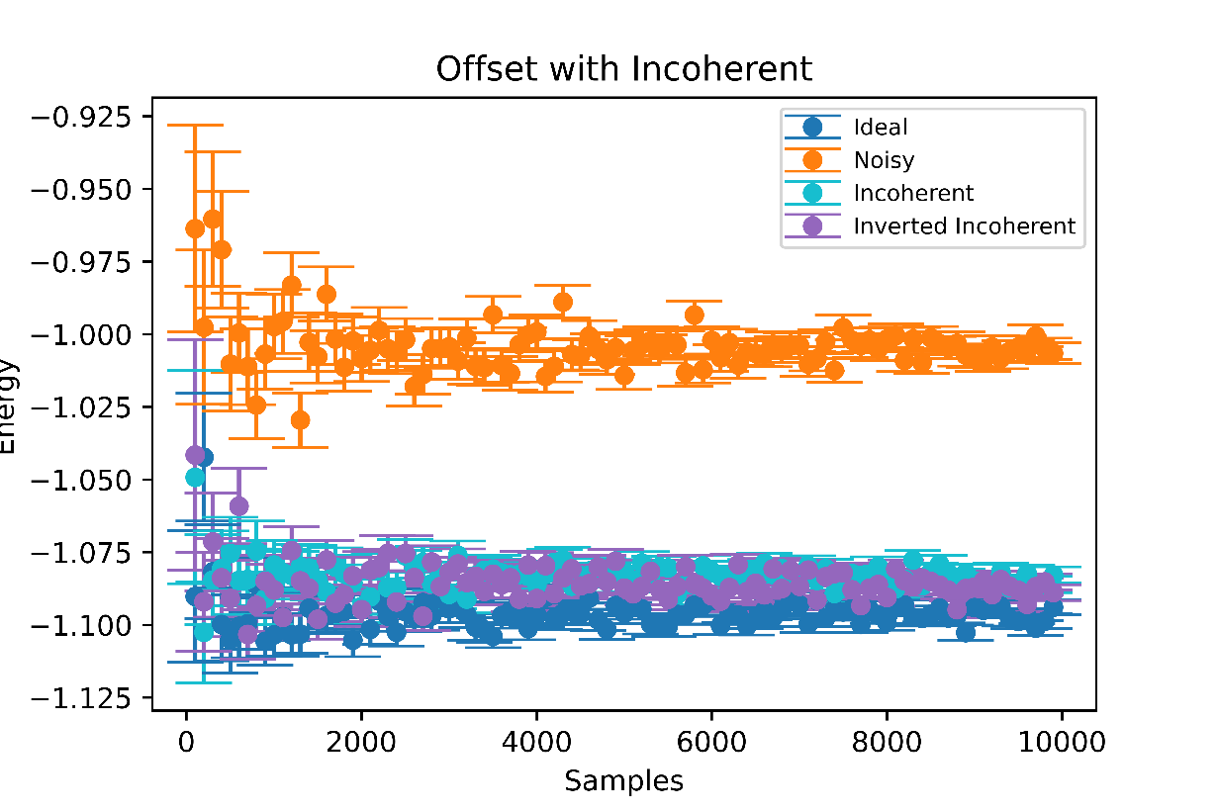
Issue 1.2: Incoherent Errors Asymmetry
Lets try to see if we invert our circuit, does the energy change if our noise model is made of purely incoherent errors?
The purple and cyan points are slightly off balance but no significant shift in energy.
Failure to get any change in energy ties into issue 2--- is the gate length the reason why we don’t get this shift?

Slide 7
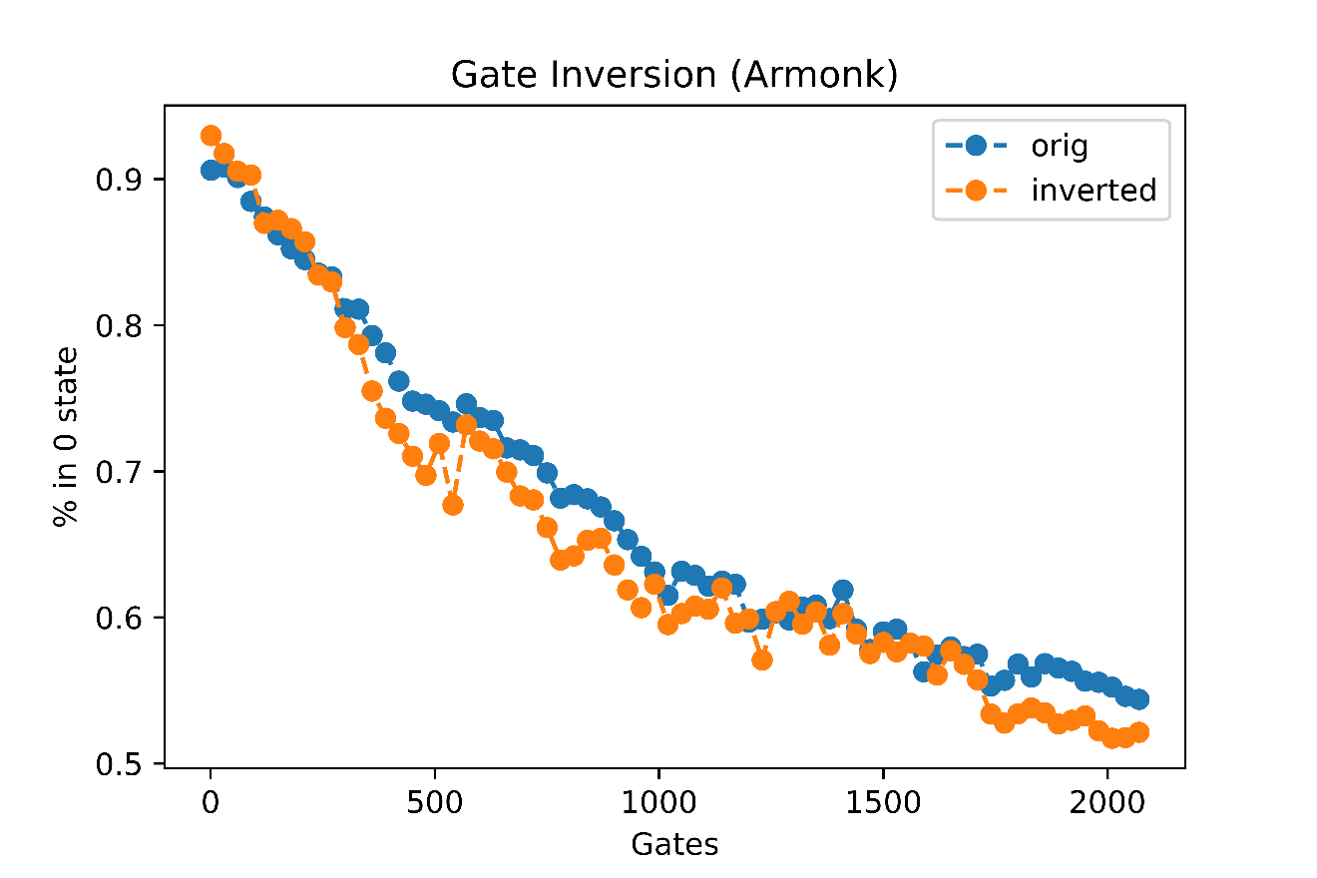

Issue 2: Gate Length and Inversion
Let’s invert a 1 qubit circuit by changing sign of angles of U3 gates and inserting 2 X gates , one before and after the circuit
Also, suppose our original circuit is equivalent to identity (so we should get a 0 state at the end)
Figure shows that inverting a circuit as described doesn’t change decay rate.
Possible Issue: Maybe measurement error asymmetry interfering?
Ran on Armonk Device since 1 qubit circuits

Slide 8
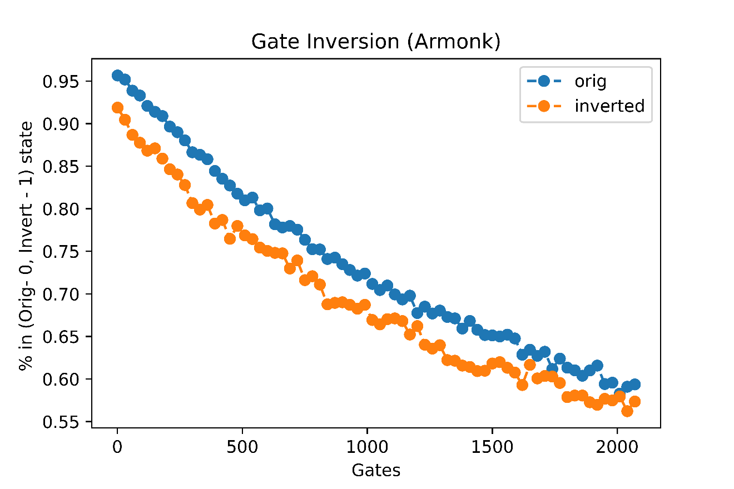
Issue 2: Gate Length and Inversion
Repeat previous procedure but in the end of inverted circuit, don’t insert the X gate
So for inverted circuit, on ideal quantum computer, we should get only 1 state
We do so to avoid the measurement error interfering with results
Result: There is an offset but inverted is decaying on the same “pace” as original.

Slide 9
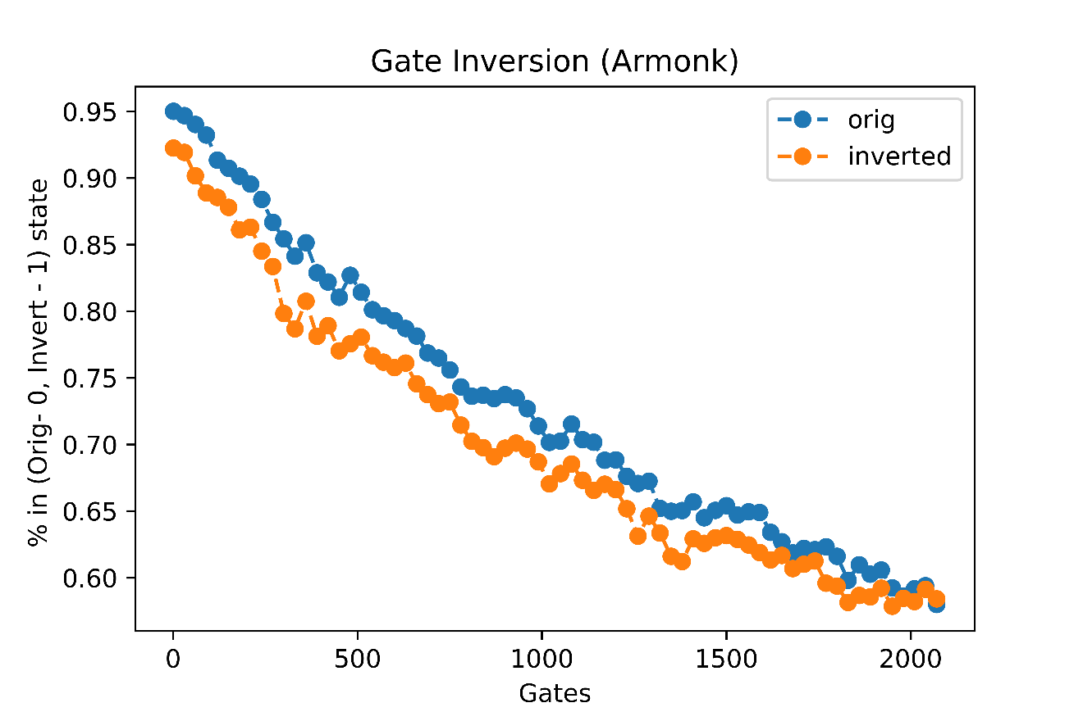
Issue 2: Gate Length and Inversion
Now in randomized benchmarking, all circuits are equivalent to the identity.
So the inversion process can be made even simpler: Just insert an X gate in the beginning of the circuit.
The result looks similar to the previous one where we also changed signs of angles of U3 gates but here, the offset is smaller.
Coming back to the question: Why are both inverted and original decaying?
The answer may have to do with path dependence of incoherent-error-asymmetry.

Slide 10
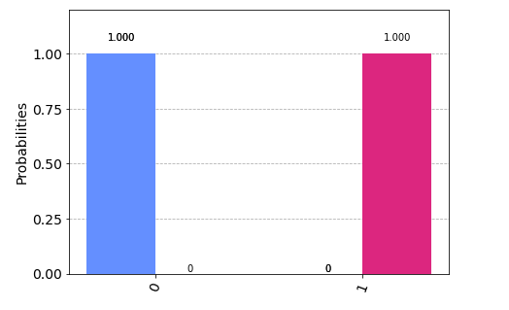
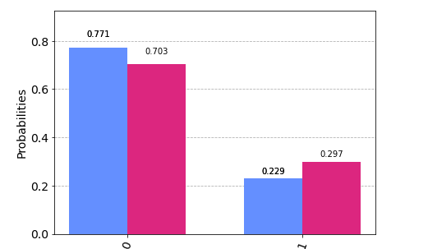
Path Dependence of Asymmetry
Ideal
Suppose we have a qubit initialized in the zero state (blue) and over 1000 steps, it makes a pi/8 rotation about the x axis of bloch sphere. After those 1000 steps, qubit is reverted back to its initial state.
In other words, over the course of 1001 gate operations, its in the same hemisphere.
Inverting this situation, we get the red qubit which is initialized in 1 state and over the 1000 steps, it stays in that lower hemisphere of the bloch sphere.
Amplitude damping (caused by incoherent errors) will act differently on the qubits:
In the blue case, the damping will try to shift the vector towards the 0 state (north pole)
In the red case, the damping will try to shift the vector towards the equator and hence away from the 1 state i.e. south pole
Because amplitude damping is different in both cases, the noise model show that there will be an asymmetry
Noise Model

Slide 11
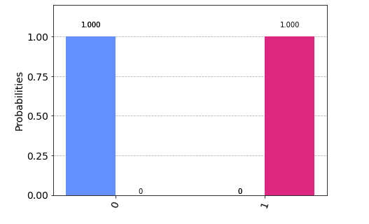
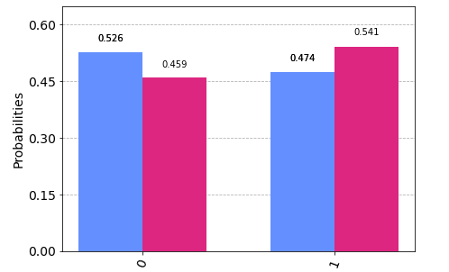
Path Dependence of Asymmetry
Now suppose the blue and red qubits don’t spend their time in the same hemisphere.
In this experiment, the blue and red qubits do 1000 bit flips. At the end, they return back to their initial state.
Since qubits are regularly visiting both hemispheres, the effect of amplitude damping will not be asymmetric
What this shows: Asymmetry of incoherent errors may be more apparent if qubit spends disproportionate time in one of the 2 hemispheres

